Slide 1












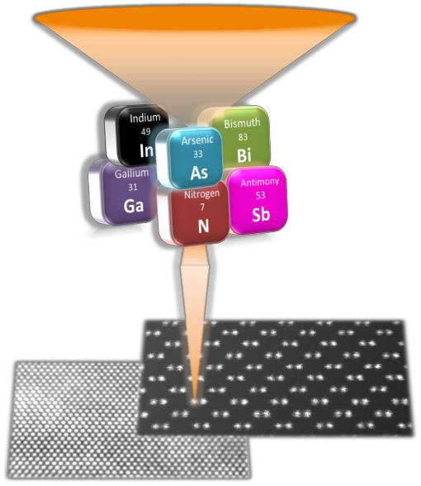



TEM ANALYSIS OF Sb-BASED III-V
SEMICONDUCTOR QUANTUM STRUCTURES FOR
LEDS AND LASERS
Atif Alam Khan
ESR, Cádiz
INNANOMAT GROUP (MATERIALS and NANOTECHNOLOGY for INNOVATION)
Department of Material Science, Metallurgical Engineering and Inorganic Chemistry, IMEYMAT Faculty of Science
University of Cádiz
11510 Puerto Real, Cádiz, Spain.
Date: May 19, 2016
1/12

Slide 2





Introduction
Objective
Methodology
Results
Future Goals
Outline
Introduction
Objective III.Methodology IV.Results
  InSb (InSb/InAs and InSb/GaAs) QDs for MIR
LEDs/Lasers
V. Future Goals
2/12

Slide 3



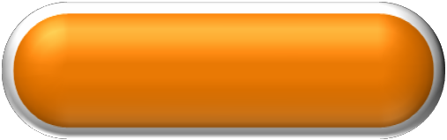




IInnttrroodduuccttiioonn
Objective
Methodology
Results
Future Goals
InSb QDs
InSb QDs support small electron effective mass at room temperature.
The QDs also offer either direct type-I band gap alignment or the incorporation of two group-V elements (As and Sb).
LED
Laser
The QDs layers with InAs or GaSb or AlGaSb capping layers tend to suffer a high lattice mismatch induced dislocations.
Direct and Narrow
Bandgap Energy
3/12

Slide 4



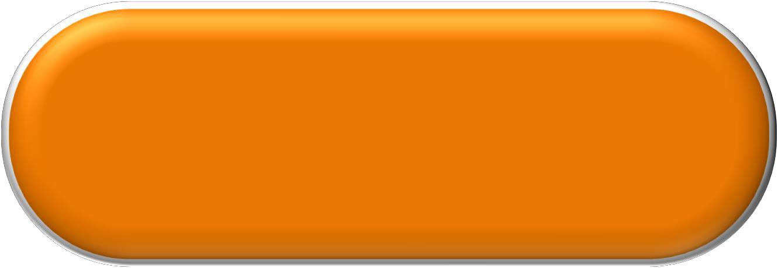



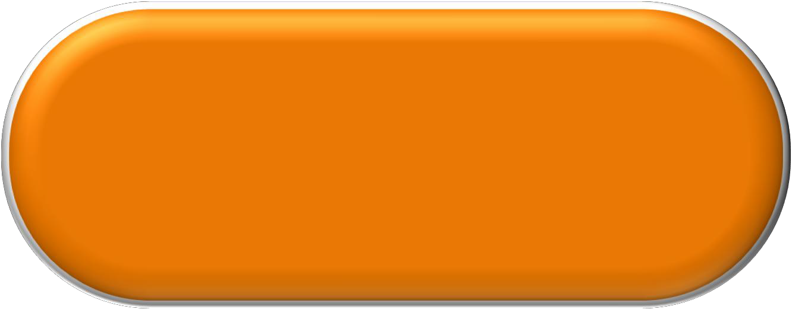
Objective
Introduction
Methodology
Results
Future Goals
Investigation on structural properties and compositional distribution of the InSb QDs samples
Correlating intensity profiles to composition using HAADF-STEM analysis with atomic column resolution
4/1⁴ 2

Slide 5



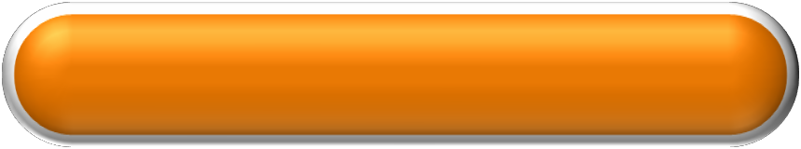
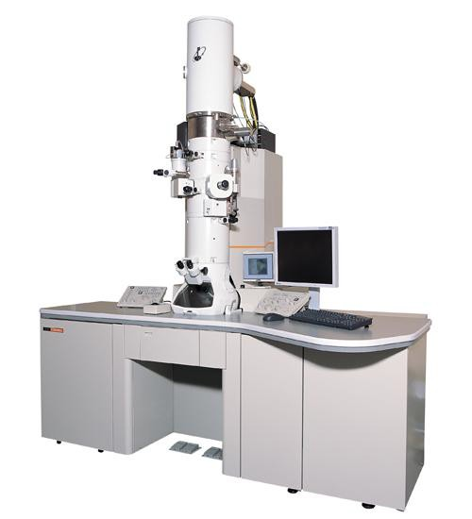

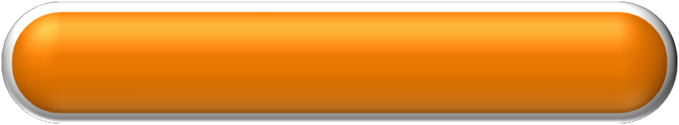

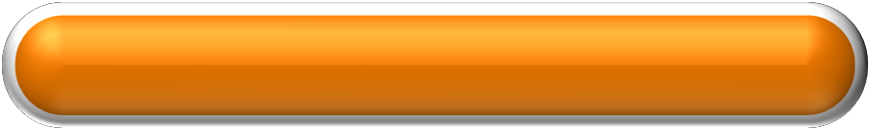









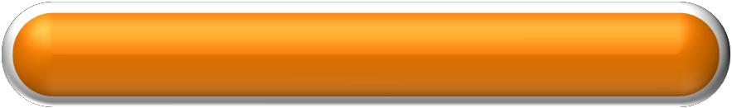
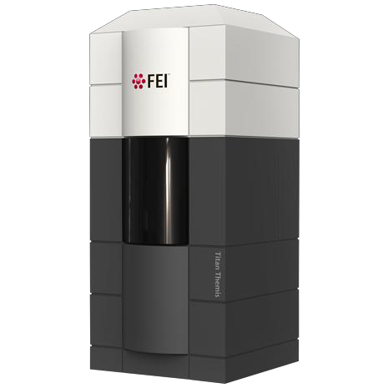
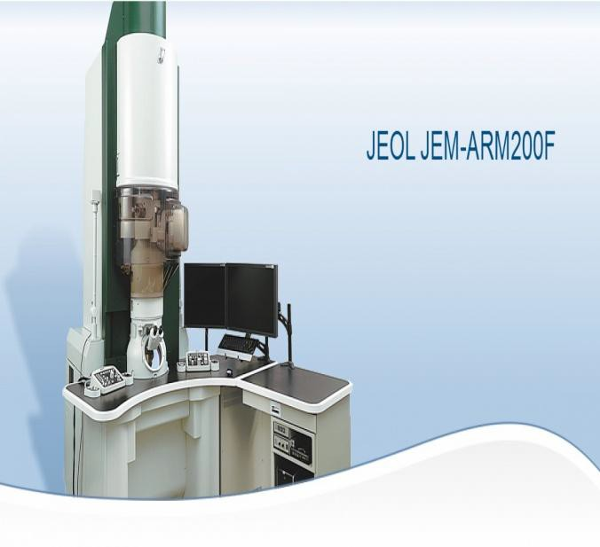
Motivation Objective
Methodology
Results
Future Goals
Conventional Sample Preparation
JEOL
2100
Diffraction Contrast
Microscopy
HAADF-STEM Microscopy
Compositional Profiling
JEOL JEM- ARM200F
Titan
Themis
5/12

Slide 6





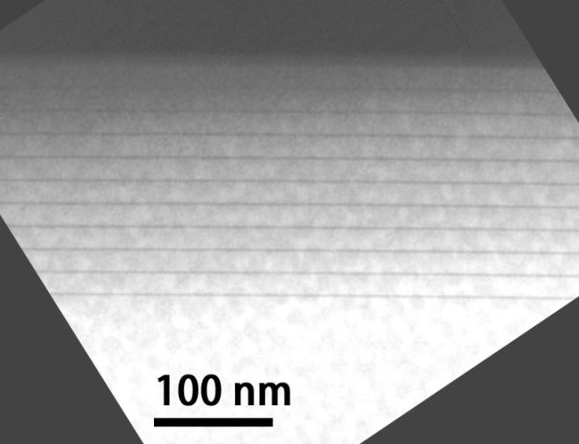
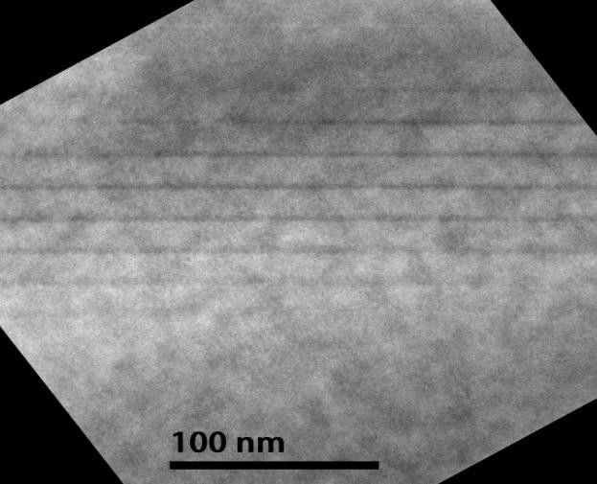
Introduction
Objective Methodology Results
Future Goals
InSb/InAs QD for LEDs/lasers
InAs
InAs
InAs buffer
InAs substrate
InAs
InAs
10 period InSb/InAs
InAs
InAs
002 DF 220 BF
We have studied two samples with the same structure but with two different thicknesses within InSb/InAs QDs layers stack: 3nm/15nm and 1.4ML/18nm, respectively.
No dislocations have been observed within the Insb/InAs QDs layers.
⁶6/1⁶ 2

Slide 7



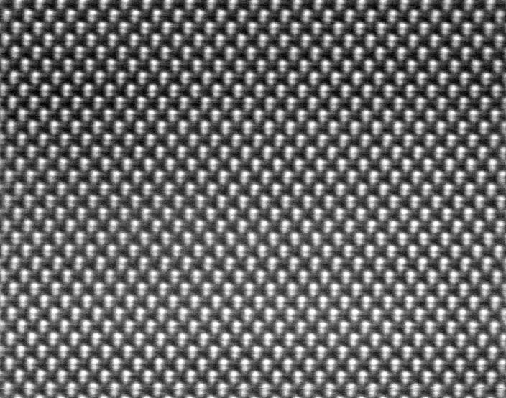



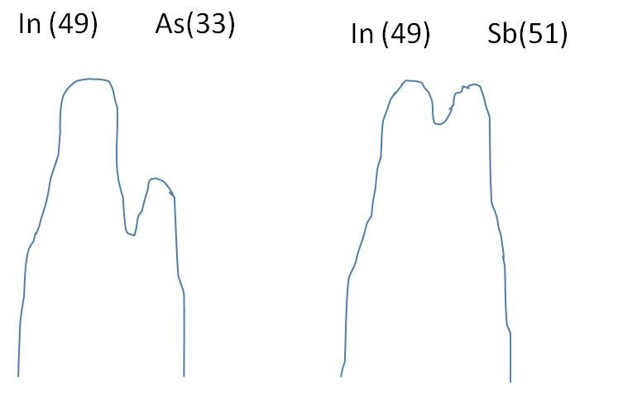
Introduction
Objective Methodology Results
Future Goals
InSb/InAs QD for LEDs/lasers
Objective:
Analysing the Sb distribution through the study of the intensity in atomic column resolution HAADF images.
Atomic dumbbells within a InSb/InAs QDs layer (JEOL JEM-ARM200F at 200 keV)
The intensity (I) at HAADF images is proportional to the squared average atomic number (Z) of the atoms in an atomic column, I ~ Z².
Ideal elemental profile
⁷7/17 2

Slide 8






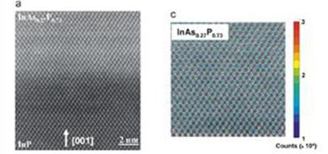
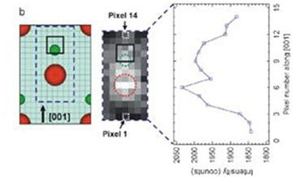
Introduction
Objective Methodology Results
Future Goals
InSb/InAs QD for LEDs/lasers
Method:
Elimination of the background signal.
Thickness calibration of the obtained images.
Peak detection of individual atomic dumbbell.
Intensity profiling based on anionic (Sb and As) elemental variation in accordance to the cation (In).
Correlating the intensity to the Sb composition.
S. I. Molina, D. L. Sales, P. L. Galindo, D. Fuster, Y. González, B. Alén, L. González, M. Varela and S. J. Pennycook, Ultramicroscopy, vol. 109, pp. 172-176, 2009
⁸8/18 2

Slide 9
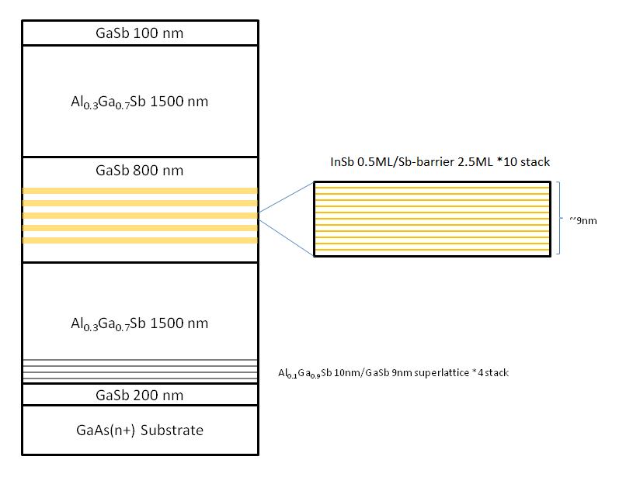
Introduction Objective Methodology Results
Future Goals
InSb/GaAs QD with Sb-based barrier for LIR LEDs/lasers
Sb-based Barrier layers:
We have studied two samples of InSb/GaAs QDs with two different types of Sb-based barrier layers: GaSb and AlGaSb.
QDs layers
The samples include filter layers to reduce density.
Both samples have
dislocation the defect
Dislocation Filter Layers
the same in the
structures as image.
illustrated
9/1⁹ 2

Slide 10
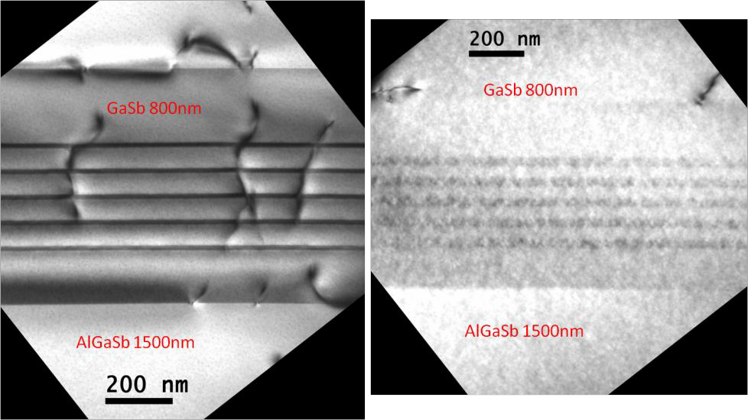
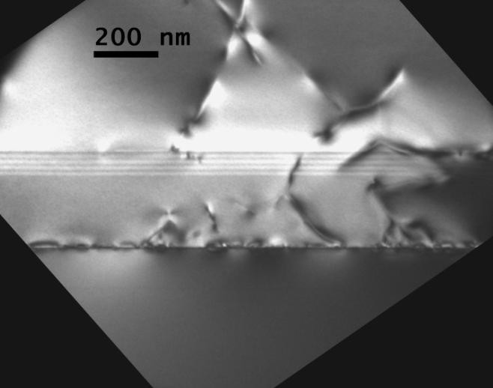
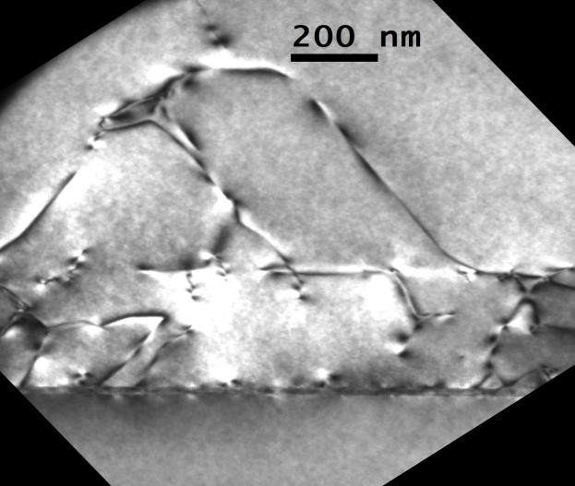
Introduction Objective Methodology Results
Future Goals
InSb/GaAs QD with Sb-based barrier for LIR LEDs/lasers
Few dislocations have been observed within
QDs layers.
Dislocations from the
QDs layers
originate interface
between the GaAs substrate and the GaSb layer.
Dislocation Filter
Layers seem to reduce the density of the dislocations gliding up
Dislocation Filter Layers
towards the InSb QDs layers, althought they cannot eliminate those dislocations completely.
GaAs substrate
GaAs substrate
002 DF
220 BF
10/¹1⁰ 2

Slide 11
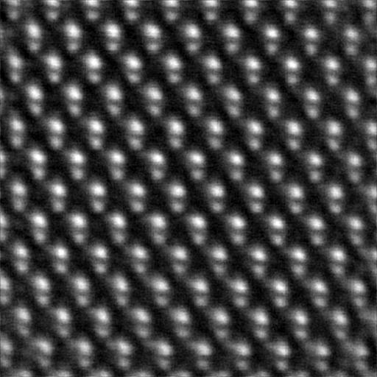
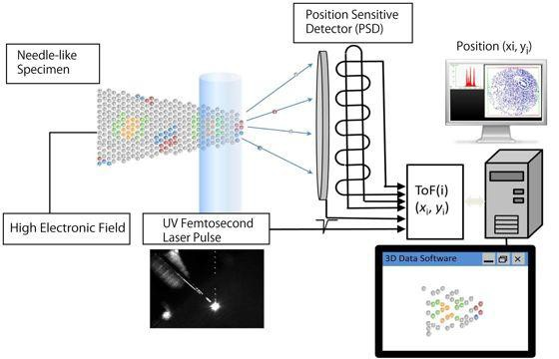
Introduction Objective Methodology Results
Future Goals
InSb/GaAs QD with Sb-based barrier for LIR LEDs/lasers
Objective:
Analysing the In
distribution
through the
study of the intensity resolution HAADF images.
in atomic
column
Atomic dumbbells within a InSb/Sb-barrier
QDs layer (JEOL JEM-ARM200F at 200 keV)
In this case,
this analysis is
more three
complicated because
there are
different group-III atoms: In, Al and Ga. Therefore, the samples are being analyzed by Atom Probe Tomography (APT).
APT:
3D spatial resolution achievable.
Chemical sensitivity.
APT working principle
¹1¹1/¹1¹ 2

Slide 12




Introduction
Objective
Results
Methodology
FuCtuornecGluosiaolsns
Study of Compositional Distribution using
HAADF and APT.
Secondment to Montpellier in June for MBE
training.
Collection of new batch of samples consisting of GaSb/InAsSb metamaterials for gas sensing and III-Sb/Si for high-efficiency solar cells from Montpellier for TEM analysis.
Participation in TEM-UCA course in July and EMC 2016 Conference in August in Lyon.
12/12

Slide 13






Daniel Fernández de los Reyes ¹³
13
Cádiz

Slide 14




